Slide 1
PUBLIC TRANSPORTATION AND OPTIMIZATION

Slide 2
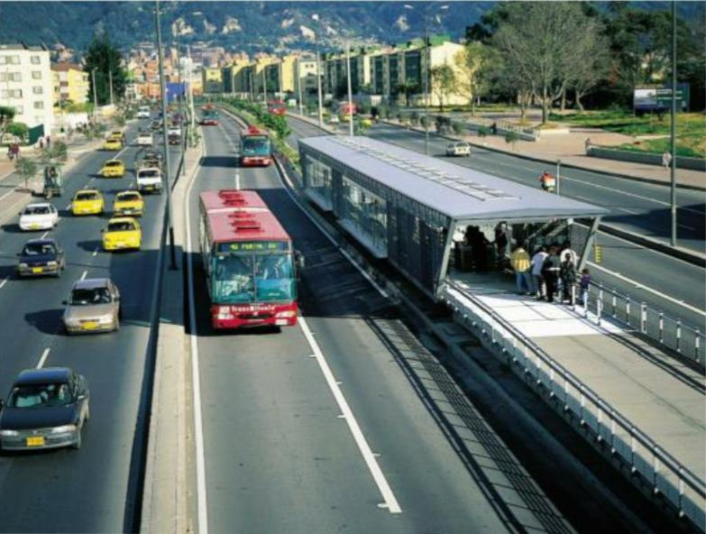
IOT IN PUBLIC TRANSPORT

Slide 3
INTRODUCTION
While public transportation comes in many forms, it can be defined as a system that moves people from one area to another in an efficient, affordable manner. The vast majority of public transportation is funded and operated by local government authorities.
The Internet of Things technology will continue to improve the passenger experience for public transportation by offering real-time vehicle tracking, improved responses in the event of an unexpected event, and personalized travel information.

Slide 4
SMART TRANSPORT
Smart transportation refers to the integrated application of modern technologies such as cloud computing, wireless communication, location-based services, and computer vision into the transportation system.
Manages congestion and incidents to maintain a good level of service to road users. Provides the means to limit air pollution and noise from road transport – contributing to a better quality of public and environmental health. Supports a lively economy and the efficient transport of goods and freight.
Real-time asset/resource visibility. Reduced costs. Improved operational efficiency. Data-driven insights for quick decision-making. End-to-end, remote monitoring and management of assets/resources. Real-time, predictive and prescriptive insights. Improve end-customer experience.

Slide 5
ACCIDENT SENSOR
Accident detection using ultrasonic sensor provides the facility to detect an accident not only in various street situations but also it might perform well under various natural conditions like rains.
Crash detection uses various sensors and accelerometers to measure the force of an impact. If this force exceeds a certain threshold, indicating that a crash has occurred, the device will alert emergency services or send a distress signal to a designated contact.

Slide 6
GPS
Location — Determining a position. Navigation — Getting from one location to another. Tracking — Monitoring object or personal movement. Mapping — Creating maps of the world. Timing — Making it possible to take precise time measurements.

Slide 7
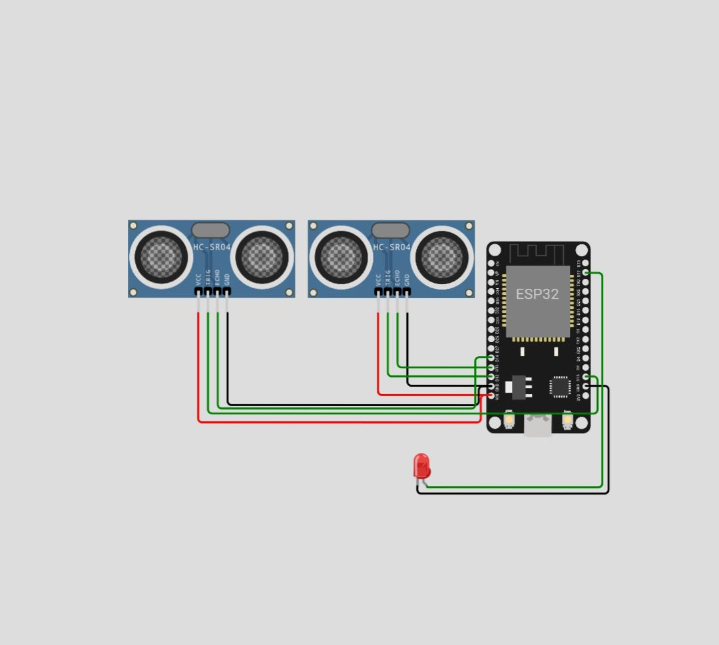
SIMULATION DIAGRAM

Slide 8
CODING
# Sample code for data collection and management class TransportationData: def __init__(self): # Initialize and collect data about transportation infrastructure self.routes = {...} # Information about bus routes, subway stations, etc. Self.accessibility_info = {...} # Details on accessibility features def get_accessible_routes(self, user_preferences): # Method to filter and retrieve accessible routes based on user preferences accessible_routes = [...] # Code to filter routes based on accessibility info and user preferences return accessible_routes # Sample code for route planning and optimization class RoutePlanner: def __init__(self, transportation_data): self.data = transportation_data

Slide 9
def plan_route(self, start, destination, user_preferences): accessible_routes = self.data.get_accessible_routes(user_preferences) # Implement algorithm to find optimized route from start to destination optimized_route = [...] # Algorithm to find the best route return optimized_route # Sample code for user interface (basic implementation) class UserInterface: def __init__(self, route_planner): self.route_planner = route_planner def get_user_input(self): # Code to get user input (start, destination, preferences) user_input = [...] # Collect user’s input return user_input

Slide 10
def display_route(self, route): # Code to display the recommended route to the user # Display route on the interface # Example usage transport_data = TransportationData() planner = RoutePlanner(transport_data) interface = UserInterface(planner) user_input = interface.get_user_input() route = planner.plan_route(user_input[‘start’], user_input[‘destination’], user_input[‘preferences’]) interface.display_route(route)

Slide 11
USING MIT APP INVENTOR
Everything is done through a select and drop manner. This means we can select a particular chunk of code and drop in our code. Hence, no typing. Easy to test your app. We can check the app developed on desktop or laptop with the app inventor application on our mobile phones. MIT provides the user with some basic lessons which help in building that apps and that helps in a proper understanding of how the MIT app inventor platform works for the user. Useful for novices. Power of native apps with a simple UI.

Slide 12
BENEFITS
Reduces Congestion. Urban congestion is one of the greatest challenges of developed nations. ... Enhances Productivity. ... Increases Land Value. ... Financial Benefits of Communities. ... Saves Money. ... Ensures a Cleaner Ecosystem. ... Prevents Global Warming. ... Reduces Carbon Footprint.

Slide 13
HTML CODING
<!DOCTYPE html> <html> <head> <meta charset=“UTF-8”> <title>Public Transport Optimization</title> <style> table { width: 100%; border-collapse: collapse; } th, td { border: 1px solid #ccc; padding: 8px; text-align: center; } </style> </head> <bbody>;

Slide 14
<header> <h1>Public Transport Optimization Dashboard</h1> </header> <section id=“data-section”> <h2>Data Overview</h2> <table> <thead> <tr> <th>Route ID</th> <th>Stops</th> <th>Passengers</th> <th>Distance</th> </tr> </thead> <tbody> <tr> <td>101</td>

Slide 15
<td>15</td> <td>300</td> <td>10 miles</td> </tr> <tr> <td>102</td> <td>12</td> <td>250</td> <td>8 miles</td> </tr> <!– Add more rows for other routes → </tbody> </table> </section> <section id=“charts-section”> <h2>Performance Charts</h2>

Slide 16
<label for=“optimize-type”>Optimization Type:</label> <select id=“optimize-type”> <option value=“time”>Minimize Time</option> <option value=“cost”>Minimize Cost</option> </select> <label for=“constraints”>Constraints:</label> <input type=“checkbox” id=“constraints” name=“constraints” value=“constraints”> Apply Constraints </form> <button id=“optimize-button”>Optimize</button> </section> </body> </html>

Slide 17
OVERVIEW
Technology has also made transportation and logistics safer. GPS tracking and monitoring systems can help businesses keep track of their vehicles and drivers, ensuring compliance with safety regulations and reducing the risk of accidents and transport facilities for disabilities

Slide 18


